Slide 1
Meeting of National Hydropower Associations
Eddie Rich
Chief Executive
International Hydropower Association
23 April 2020
www.hydropower.org
Notes:
Just be clear that they all are not national hydropower associations but national generators associations that include all type of generators in the country (from hydro to win and maybe thermal). Like ACOLGEN in Colombia or Generadoras de Chile. In any case, they are the representatives of the hydropower generators in the country.

Slide 2
Intro by Eddie Rich, IHA CEO
Round table discussion of updates on how associations are handling Covid-19 issues in their countries.
Next steps (final slide)
This is the presentation title
Meeting Agenda
www.hydropower.org

Slide 3
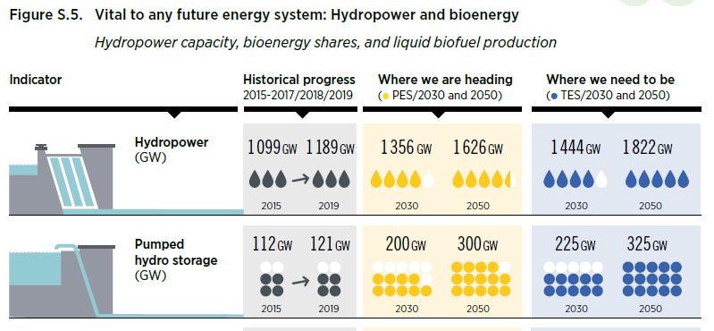
Achieving Paris Goals – hydropower’s role
Synergy between hydro & interconnection
850 GW new hydro capacity needed to limit temperature rise by 2°C
Hydropower capacity needs to increase by 60% by 2050
equivalent to the entire power capacity of the EU
[Source: IRENA, 2020]
Notes:
IRENA Global Outlook Report 2020 came out this week, which estimated to limits the rise in global temperature to well below 2 degrees Celsius above pre-industrial levels, hydro installed capacity will need to increase by 850 GW. Hydropower capacity needs to increase by 60% by 2050.
According to @IRENA, an additional 850 GW of new #hydropower capacity is required in the next 30 years, equivalent to the entire power capacity of the EU
“Increasing hydropower capacity does not specifically entail only building new dams: options also exist to upgrade turbines and systems in existing plants, utilise run-of-river designs and electrify non-power dams. Yet for new hydropower plants, planners need to consider local environmental impacts, and engage in discussions with communities in the impacted areas. Hydropower plants will also need operational changes that reflect changing power system needs, including faster and more frequent ramping, and planning practices that include evaluating the impacts of climate change on water supply and reservoir storage requirements. Due to longer planning cycles for new hydropower dam construction, policy makers and planners need to start thinking now about new projects. For existing dams, investments are needed to modernise old hydro plants.”
Hydropower continues to play a significant role in future energy systems, even more importantly, hydropower is a dispatchable power. All countries that achieved 100 per cent renewable electricity rely on hydropower. Hydropower’s contribution in maintaining system reliability has not been recognised.
The world will require more hydro to provide low-carbon energy and support VRE integration.

Slide 4
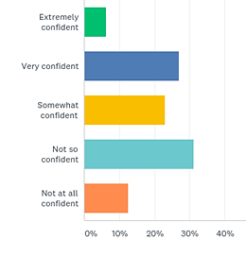
Impact of COVID-19 on the hydropower sector
Synergy between hydro & interconnection
Impact on new projects:
Supply chain disruptions
Travel restrictions preventing expertise on site
Reduced investor confidence
EPC, financing and PPAs costs and terms renegotiated
Delayed and cancelled projects
Impact on existing projects:
Decreased energy demand and electricity price
Payment defaults by customers
Significant drop in EBITDA
Operation and maintenance difficulties
Q: I am confident that my organisation's hydropower revenues will grow over the next 1-3 years.
[Source: IHA member survey 2020]
Notes:
Initial feedback from survey. IHA will carry out further analysis. Much of the information is anecdotal and too early in the crisis for clarity. But overall the confidence is down from about 70% to 50% from the member survey a year ago.
Supply chain disruption and restricted movement and inability to travel, will cause delay in project completion as well as environmental compliance in new projects.
On Indonesia’s Sumatra island, Batang Toru hydropower plant has ground to a halt due to a lack of Chinese workers, after Indonesia halted all flights to and from mainland China.
In Nepal many Chinese workers who left on holiday have also not returned.“ Many of them are in specialised work, and it is not easy to replace them locally. In their absence, projects are being delayed or slowed down,” said Vishnu Bahadur Singh from the Nepal Hydropower Association.
The weaker fiscal position of governments due to an economic slowdown also poses a significant downside risk to the completion of new large-scale hydroelectric power projects over the medium term, increasing the risk of delays and cancellations most prominently on primarily government-funded projects
In Brazil, there was a cancellation of the new round of energy auctions.
Potential impact of Power Purchase Agreements on new power projects in cross border power trade
We welcome more anecdotal inputs.

Slide 5
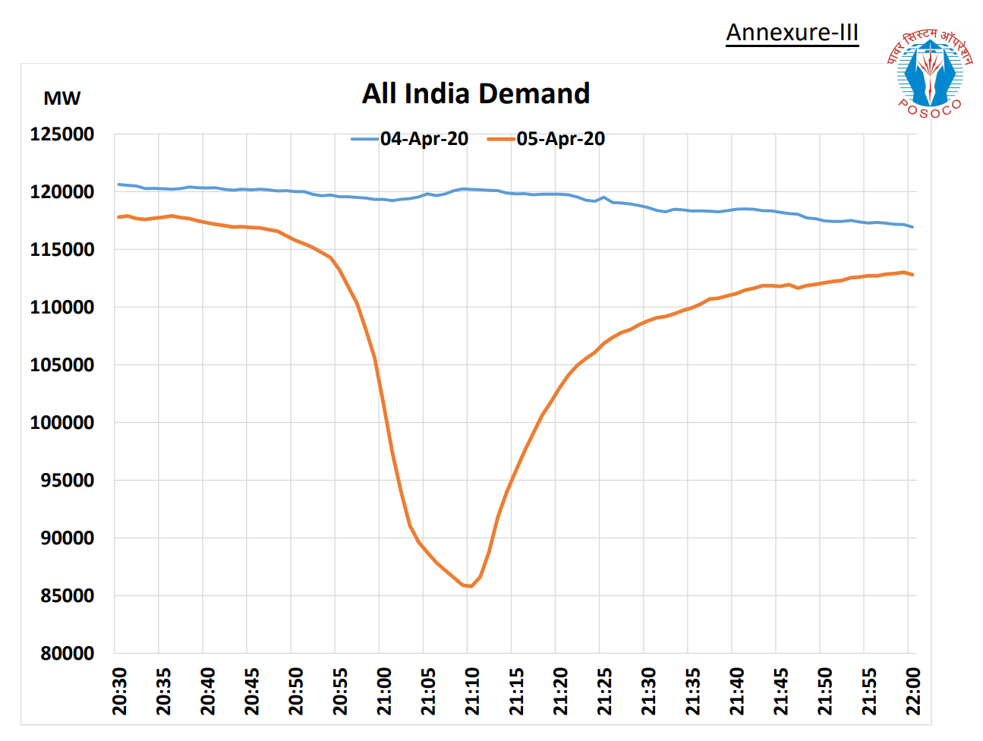
Hydropower’s role demonstrated during COVID-19
Synergy between hydro & interconnection
Hydropower is keeping the lights on:
Indian hydro hailed for restoring power amid Covid-19 vigil
Other examples:
Sequestration from the hydropower sector in the US.
UK wind farms switched off. Pumped storage can pick it up.
Hydro’s essential role in ensuring reliable power supply to sustain society e.g. medical services
[Source: Power System Operation Corporation Limited (POSOCO), India]
Notes:
In perhaps the largest electricity experiment the world has even seen, India’s hydropower sector was heralded last week for restoring electricity to tens of millions of households following a huge plunge in demand.
Source of information
https://posoco.in/wp-content/uploads/2020/04/Preliminary-Report-on-Pan-India-Light-Switch-Off-Event-on-5th-April-2020-2-5.pdf
https://pib.gov.in/PressReleseDetail.aspx?PRID=1610559
https://www.livemint.com/news/india/those-long-9-minutes-when-india-s-power-grid-operators-held-their-breath-11586143504936.html

Slide 6
Post-COVID
Major changes - major challenges - major opportunities
Unprecedented volatility and uncertainty
Transformation of the energy sector.
Highlighted the relative stability of cash flows that hydropower deliver over the long run
Notes:
IEA: “Comparisons with previous periods of disruption in oil markets are inevitable but misplaced. The oil industry has never seen anything like 2020.”
The recent volatility in the oil markets has once again highlighted the relative stability of cash flows that renewable energy projects, in particular hydropower, can deliver to investors over the long run

Slide 7
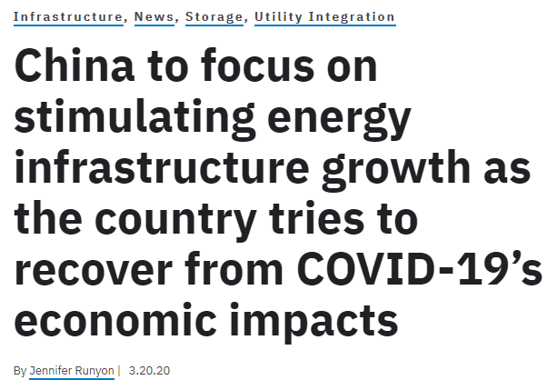
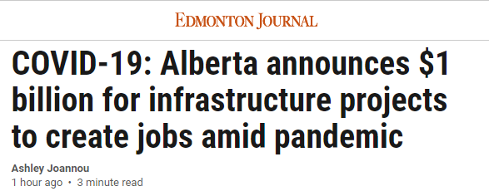
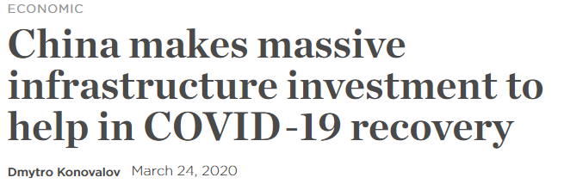
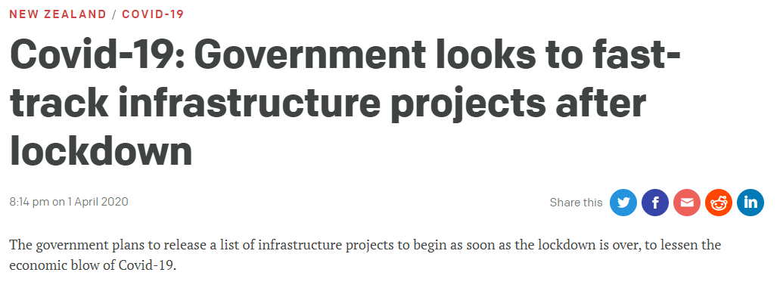
Post-COVID
Major changes - major challenges - major opportunities
Massive government stimulus packages planned
More important than ever to have a voice at the table.
Hydropower´s value needs to be adequately recognised.
www.hydropower.org
Notes:
More stories emerging from China – big ramp up in coal power stations, but also massive investment and employment scheme for pumped hydro and grid infrastructure. (4th Five-Year-Plan is being drafted by the end of the year)

Slide 8
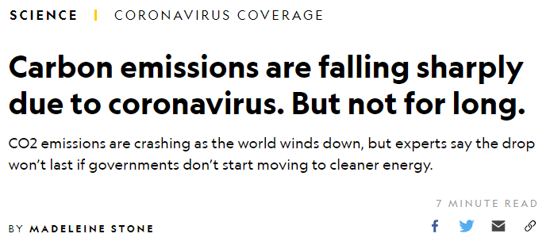
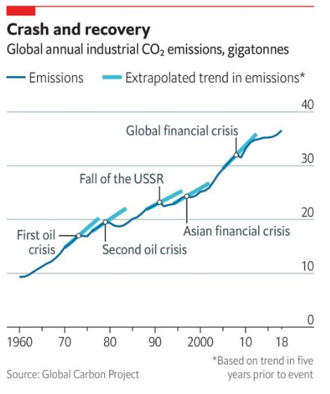
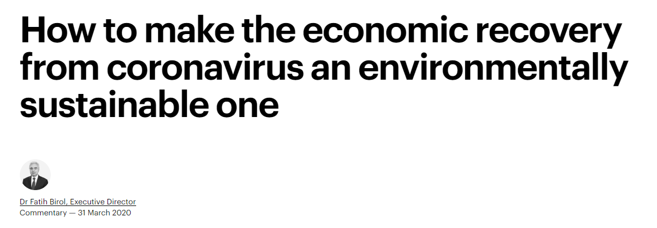
Post-COVID
Major changes - major challenges - major opportunities
The next year will lay the foundations for the next decade
Advocating for renewable energy is more important than ever.
A sustainable, low-carbon emissions energy world come become a reality
Notes:
“Hydropower, an often forgotten workhorse of electricity generation, remains an essential source of flexibility.” said IEA head Fatih Birol
Positive effect : increased global awareness on environmental issues & climate change

Slide 9
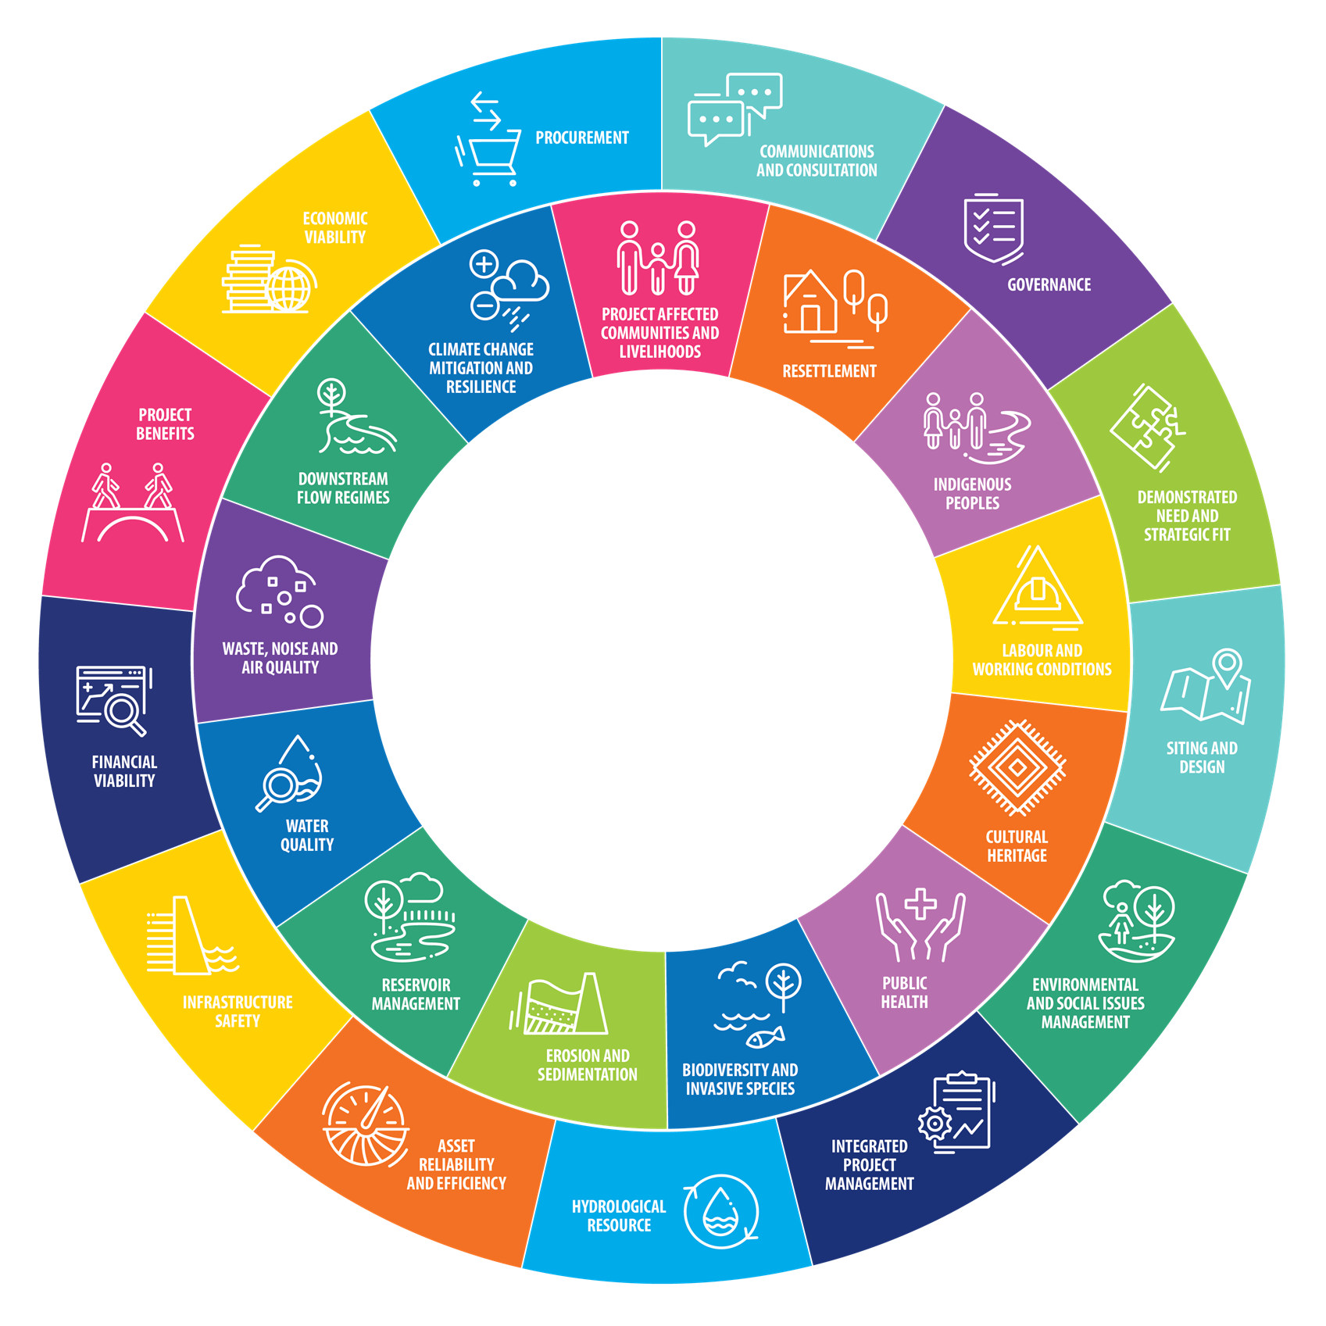
Key message to hydro operators and developers
Have shovel-ready projects in place for the post-Covid 19 economic stimulus plans.
Make sure your projects have been assessed against the Hydropower Sustainability Tools.
Demonstrate renewable coordination through hybrid projects, such as solar PV or pumped storage alongside solar or wind power.
Notes:
The three glues of membership.
Shouldn’t it be addressed to all Hydropower operators and developers?

Slide 10
Key message to governments
More and better hydropower is an essential part of energy transition and wider development strategy. This should include modernisation and rehabilitation projects.
Create enabling policy framework as fast track approval mechanisms; review of tax breaks; regional interconnections and power pools; hydropower purchase obligations; etc.
Value hydropower in the market, recognise its value over the long-term, its multiple benefits and its storage and flexibility.
Notes:
The three glues of membership.

Slide 11
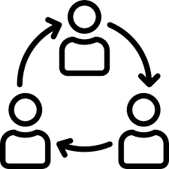
Collaboration moving forward
1. Positioning the sector for Covid and post-Covid
Joint statements/media articles
Regional and national dialogues (online webinars and in-person)
Using seat at the international, regional and national tables:
United Nations, IRENA Hydro Group, IEA, World Bank, International Forum on Pumped Storage etc.
2. Advancing policy
Sharing information on policy measures (Hydropower Pro)
Joint policy papers from associations
3. Improving hydropower sustainability and climate resilience
Through capacity building on sustainability assessment, climate resilience and GHG emission tools
4. Building a vibrant international community
IHA Membership – international network for opportunity and experience sharing

Slide 12
Thank you
You can also become an IHA member: www.hydropower.org/join
To learn more about sustainability tools, visit:
www.hydrosustainability.org
www.hydropower.org
Notes:
There is huge opportunity ahead for sustainable development of across the world, especially in Africa. Hydropower coupled with interconnection will contribute to green, low carbon development.

